Slide 1
Giacomo Setaccioli’s Clarinet Sonata:
A Study of Semiotics and Performance Decisions

Slide 2
Presentation Outline
Semiotics
  Specific techniques
Setaccioli
Sonata
Extra-Musical components
Meriggio analysis
Performance

Slide 3
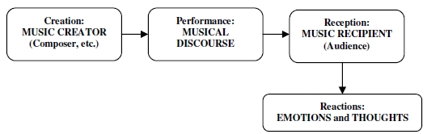
Semiotics
How signs and symbols function in communication
Chain of communication within music:
    Composer through notation to performer
    Performer through audible music to audience
Emotional plane

Slide 4
Semiotics
“Musical Semiotics is a discipline in flux, a science under construction.”—Eero Tarasti, A Theory of Musical Semiotics
Structural
  Linguistic, grammatical, logical
  Form and harmonic structures
  Internally referential, using universal components
Iconic
  Metaphors, symbolism, deeper meaning
  Symbolism, Leitmotifs
  Externally referential, internally functional

Slide 5
Approaches to discovering Semiotic Musical Meaning
Narrativity
Signs/Gestures
  Harmonic Structure
  Thematization
  Markedness
Representamen: The sign.
Object: The signified, what is represented by the sign.
Interpretant: How the representamen and object are linked.
When A is a representamen (sign), B is an object (signified), and C is an interpretant, then A means B by virtue of C.

Slide 6
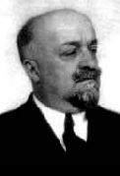
Giacomo Setaccioli
1868-1925
Italian composer, conductor, theorist.
Studied flute and composition at Liceo Musicale di Santa Cecilia.
Most of his works are lost, including a symphony.

Slide 7
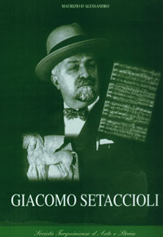
Giacomo Setaccioli
“A tendency to strike a balance between elements which are difficult to reconcile is characteristic of Setaccioli’s extant work in general.”
–Robert Cognazzo, “Setaccioli, Giacomo,” Grove Music Online

Slide 8
Sonata for Clarinet and Piano in Eb, Op. 31
Lyrical, virtuosic, harmonically rich
Meriggio: Many moods and melodic ideas
Notturno: Harmonically complex with a contrasting interlude
Alba: Virtuosic and bright with Brahmsian episodes
Well-received by critics
Date Unknown/ 1921

Slide 9
“Among the extra-ordinary concerts of the month I must not omit to mention one given at the Philharmonic Hall, in which a new and notable composition of Giacomo Setaccioli had its baptism. Signor Setaccioli is the director of the Philharmonic Society, and his new work, which bears the Opus No. 31, is a Sonata in E flat major, for clarinet and pianoforte. The clarinet as a solo instrument is not much in vogue to-day, and Setaccioli has followed the lead of Strauss in trying to restore it to its place of honour. The new work, in three movements, had a great success, and has been favourably received by all the critics, who recognize in Signor Setaccioli one of the foremost musicians that Rome has produced.”
--Leonard Peyton, “New Clarinet Sonata,” Musical Times, Volume 62 (1921), 295.

Slide 10
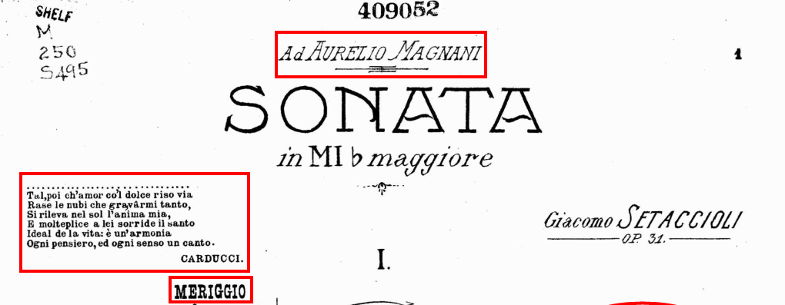


Extra-Musical References in the Score

Slide 11
Aurelio Magnani
1856-1921
Dedication is historically relevant
Famous Clarinetist and teacher
Taught at Liceo Musicale di Santa Cecilia (where Setaccioli studied)
Wrote a three-part method book for clarinet
Rhythmical similarities: Rhythmic complexities

Slide 12
Time-of-Day Titles
Meriggio or Midday/Noon
Notturno or Night
Alba or Dawn
Meant to evoke a mindset, not meant to be programmatic
“There are three movements, each preceded by a title that suggests the atmosphere of music: Noon, Night, Dawn. There is no programmatic or descriptive intent, but the musical accent is affected, as a state of mind, and impresses the course of emotional and changing musical trends.”—Guido Pannain, “Profilo musicale di Giacomo Setaccioli,” Giacomo Setaccioli, 14

Slide 13
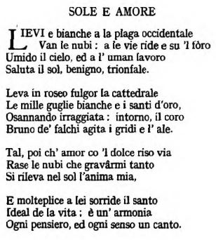
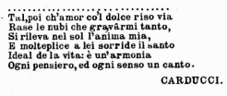
“Sole E Amore” by Giosue Carducci
From the score and part
G. L. Bickersteth, Carducci: A Selection of his Poems, with Verse Translations, Notes, and Three Introductory Essays (London: Longmans, Green, and Co., 1913), 144.

Slide 14
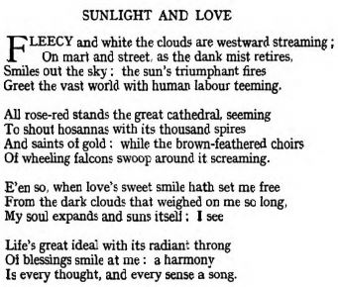
Translation “Sunlight and Love”
G. L. Bickersteth, Carducci: A Selection of his Poems, with Verse Translations, Notes, and Three Introductory Essays (London: Longmans, Green, and Co., 1913),. 144

Slide 15

Meriggio
Wide variety of characters and mood shifts
Sonata form
Tonal, but movement largely avoids melodic tonics
Chromatic, lyrical
Signs leading to narrative
Juxtaposition
Clear outlining of an easy-to-follow harmonic structure
Markedness

Slide 16
Signs
Representamen: The sign.
Object: The signified, what is represented by the sign.
Interpretant: How the representamen and object are linked.
When A is a representamen (sign), B is an object (signified), and C is an interpretant, then A means B by virtue of C.

Slide 17
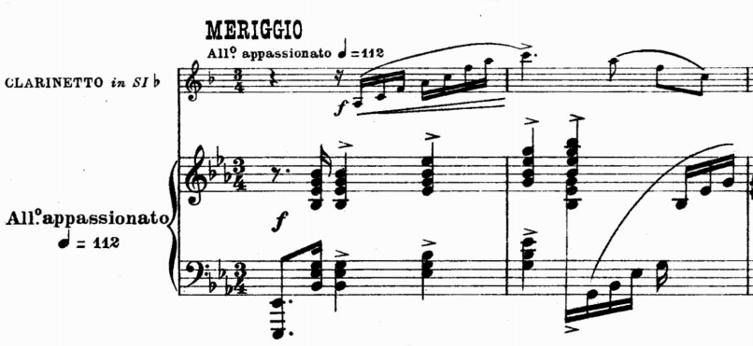
Declamatory Sign
Setaccioli, measure 1-2, page 1
According to Cooke’s The Language of Music, dotted figures depict a specific meaning:
“Loudly, in the major, they [dotted rhythms] produce an impression of pomp and splendor, or courage and confidence…”

Slide 18
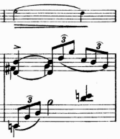
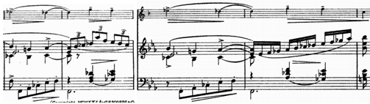
Sighing Sign
Introduction of more harmonic complexities
Passive joy or relief
Yearning, thoughtfulness
Contrast to the declamatory sign
Setaccioli, measure 3, page 1
Setaccioli, measures 11-15, page 1

Slide 19
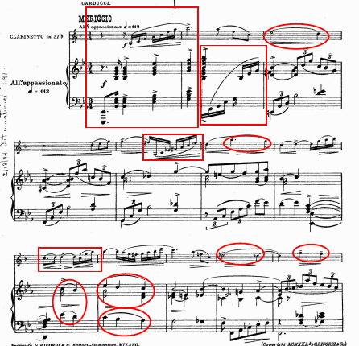
Duality of the signs
Markedness
Singular agency
Signs in epigraph narrative
Signs in time-of-day title

Slide 20
Narrativity from the signs
Musical symbols indicate moods that can combine into a coherent narrative.
Person in love
  Excited
  Complications and doubts
“E’en so, when love’s sweet smile hath set me free/ From the dark clouds that weighed on me so long.”
Excitement followed by potential for unrequited love.
Midday represented.

Slide 21
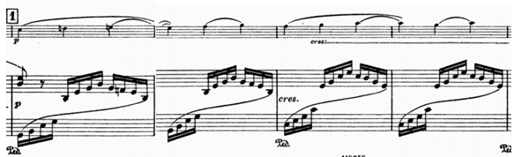
Rising Sign
Also considered the Majestic Sign
Leads into the declamatory sign
Builds joy and excitement
Setaccioli, mm. 11-14, page 1-2

Slide 22
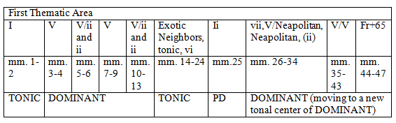
Harmonic Outline

Slide 23
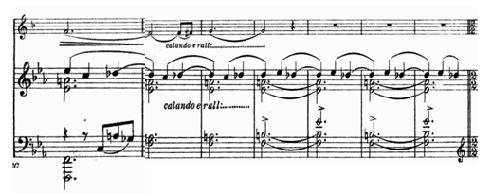
Transition
Setaccioli, mm. 42-47, page 3
Unusual Transition to the second theme group
Resolution of augmented chord is the tonic chord of the next section

Slide 24
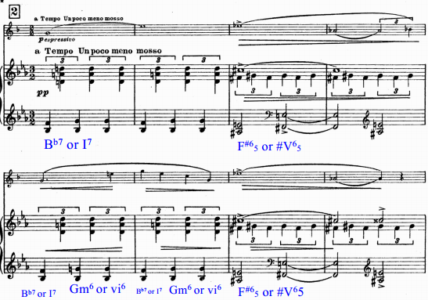
Second theme
Floating and transparent
Triple vs, Duple
Sigh
Thematized
Daydreaming
Setaccioli, mm. 48-55, page 4

Slide 25
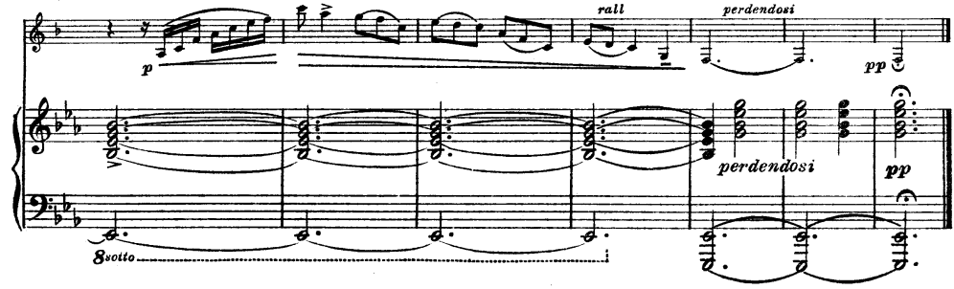
Ending
Declamatory sign, but much more subdued
Setaccioli, mm. 351-357, page 19

Slide 26

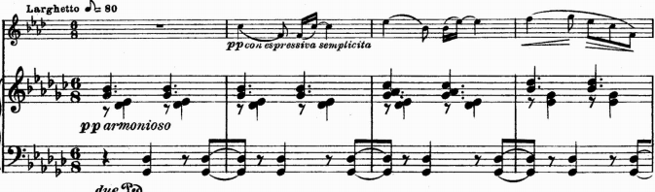
Notturno
Still and serene; energetic B section
Atypical rounded binary
Distinctive formal sections
Song-like
Mirroring 4ths and 5ths
Thematization
Contrasting B section
Dreaming
Topic theory: the Nocturne
Setaccioli, mm. 1-5, Page 20

Slide 27
Topic Theory
Notturno=Night
Notturno=Nocturne
Qualities of certain genres manifest themselves in other styles of music
Contrasting section in Chopin’s Nocturnes

Slide 28
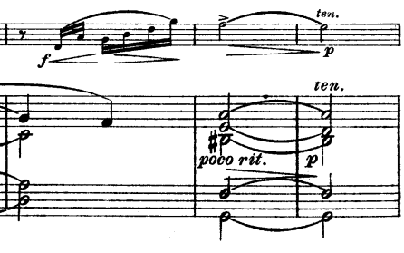
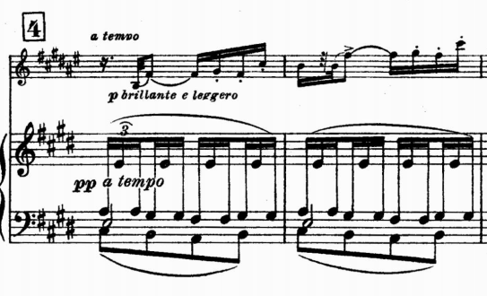
B material
Declamatory sign
Rising Sign
Technical, bright
Setaccioli, mm. 44-46, Page 22
Setaccioli, Rehearsal 4, mm. 47-48, Page 23

Slide 29

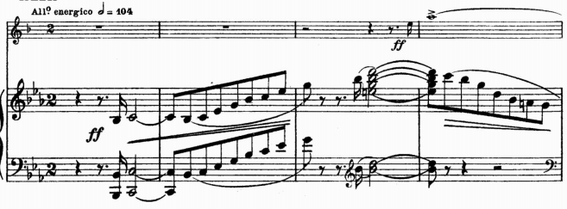
Alba
Brisk, bright movement
Occurs very quickly
Energetic
Technical
Flying rather than floating
Setaccioli, mm. 1-7, Page 27

Slide 30
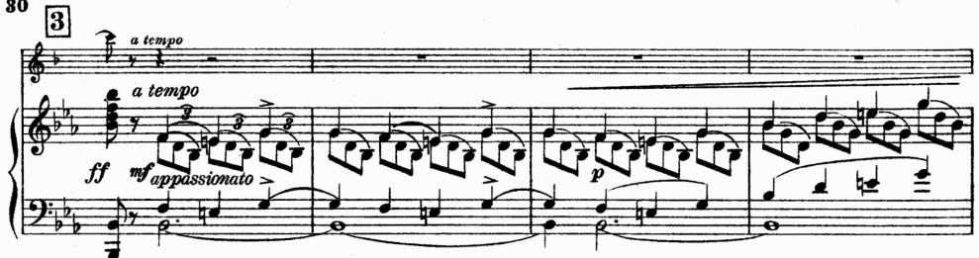
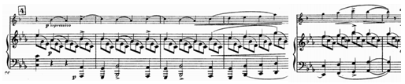
Neighbor Sign
Setaccioli III, Rehearsal 3, mm. 52-55, Page 30
Setaccioli III, mm. 72-73, Page 31

Slide 31


Performance

Slide 32
Conclusion
Semiotic Analysis
  Validate
  Clarify
  Establish
  Teach
  Understand
Setaccioli’s Sonata is suitable for semiotic analysis
Permanent Place in Clarinet Repertoire
Consider exploring musical semiotics
Consider performing or studying Setaccioli’s Clarinet Sonata

Slide 33
Bibliography
Agawu, V. Kofi. Music as Discourse: Semiotic Adventures in Romantic Music. New York: Oxford University Press, 2009.
Agawu, V. Kofi. Playing with Signs: a Semiotic Interpretation of Classic Music. Princeton, N.J.: Princeton University Press, 1991.
Bickersteth, G. L., Carducci: A Selection of his Poems, with Verse Translations, Notes, and Three Introductory Essays. London: Longmans, Green, and Co., 1913.
Briggs, Rachel and Janelle Meyer. "Structuralism." Anthropological Theories: A Guide Prepared By Students For Students. Dept. of Anthropology, University of Alabama. (April 2015.)
Cognazzo, Roberto. “Setaccioli, Giacomo.” Oxford Music Online. Oxford University Press, accessed October 21. http://www.oxfordmusiconline.com/subscriber/article/grove/music/45303.
Cook, Nicholas. A Guide to Musical Analysis. Oxford: Oxford University Press, 1987.
Cooke, Deryck, The Language of Music, Oxford: Oxford University Press/Clarendon Paperbacks, 1959/1989.

Slide 34
Bibliography continued
D’Alessandro, Maurizio. “Some Remarks Concerning the History of the Clarinet in Italy in the Nineteenth Century: Giacomo Setaccioli’s Sonata for Clarinet in the context of the Italian Instrumental Revival.” Clarinet, Vol. 22, Issue 2 (1995).
Davies, Stephen. Musical Meaning and Expression. Ithaca: Cornell University Press, 1994.
The Editors of Encyclopædia Britannica. “Charles Sanders Peirce.” Encyclopædia Britannica, Encyclopædia Britannica: January 16, 2009, accessed March 19, 2017. https://www.britannica.com/biography/Ferdinand-de-Saussure
The Editors of Encyclopædia Britannica. “Claude Lévi-Strauss.” Encyclopædia Britannica, Encyclopædia Britannica: February 09, 2012, accessed March 19, 2017. https://www.britannica.com/biography/Ferdinand-de-Saussure
Editors of Encyclopædia Britannica. “Ferdinand de Saussure.” Encyclopædia Britannica, Encyclopædia Britannica: March 3, 2009, accessed March 9 2017. https://www.britannica.com/biography/Ferdinand-de-Saussure
Editors of Encyclopædia Britannica. “Giosue Carducci.” Encyclopædia Britannica, Encyclopædia Britannica: January 12, 2000, accessed March 11 2017. https://www.britannica.com/biography/Giosue-Carducci
Gianturco, Carolyn. “Pannain, Guido.” Oxford Music Online. Oxford University Press, accessed March 2 2017. http://www.oxfordmusiconline.com/subscriber/article/grove/music/20815.

Slide 35
Bibliography continued
Hanudel. “Magnani: Clarinet Pieces.” American Record Guide. Vol. 76, Issue 2 (2013), 111.
Hatten, Robert S. Interpreting Musical Gestures, Topics, and Tropes: Mozart, Beethoven, Schubert. Bloomington: Indiana University Press, 2004.
Hatten, Robert S. Musical Meaning in Beethoven: Markedness, Correlation, and Interpretation. Bloomington: Indiana University Press, 1994.
Kruse, Felicia E. “Temporality in Musical Meaning: A Peircean/Deweyan Semiotic Approach.” The Pluralist, Vo. 6, No. 22 (Fall 2011.)
Lerdahl, Fred and Ray Jackendoff. “An Overview of Hierarchical Structure in Music.” Music Perception, Volume 1, Issue 2 (Winter, 1983-84): 229-252.
Magnani, Aurelio. Méthode Complète de Clarinette Système Boehm: En 3 Parties. Paris: Evette et Schaeffer, 1900.
Mannion, Caitlin M., and Elvira Sanatullova-Allison. “Applying the Theory of Linguistic Relativity to Music-an Initial Exploration.” International Journal of Arts & Sciences, Vol. 5, Issue 3 (January, 2012): 455-475.
Meyer, Leonard. Emotion and Meaning in Music. Chicago: University of Chicago Press, 1956.
Meyer, Leonard. Style and Music: Theory, History, and Ideology. Philadelphia: University of Pennsylvania Press, 1989.
Monelle, Raymond. Linguistics and Semiotics in Music. Switzerland: Harwood Academic Publishers GmbH, 1992.

Slide 36
Bibliography continued
Padroni, Umberto. “Giacomo Setaccioli.” Nuova Rivista Musicale Italiana, Vol. 32, Issue 1-4, pg. 482.
Pannain, Guido. “Profilo musicale di Giacomo Setaccioli.” Giacomo Setaccioli. Roma: Christen Tipografia, 1969. [ITALIAN: needs translation]
Patel, Aniruddh D. Music, Language, and the Brain. Oxford: Oxford University Press, 2008.
Peirce, Charles S. Philosophical Writings of Peirce, edited by Justus Buchler. New York: Dover Publications, 1955.
Peyton, Leonard. “New Clarinet Sonata.” Musical Times, Volume 62, 1921, pg. 295.
Reiner, Thomas. Semiotics of Musical Time. New York: Peter Lang Publishing Inc., 2000.
Ruwet, Nicolas. Syntax and Human Experience. Edited and Translated by John A. Goldsmith. Chicago: University of Chicago Press, 1991.
Setaccioli, Giacomo. Clarinet Sonata, op. 31. Milano: Ricordi, 1921.
Setaccioli, Giacomo. Debussy è un Innovatore?: Studio Critico Estetico. Roma: Edizioni Fratelli de Santis, 1920.
Tarasti, Eero. Signs of Music: A Guide to Musical Semiotics. Berlin: Walter de Gruyter GmbH & Co., 2002.
Tarasti, Eero. A Theory of Musical Semiotics. Bloomington: Indiana University Press, 1994.
Webb, Michael D. Italian 20th Century Music: the Quest for Modernity. London: Kahn & Averill, 2008.
Williams, Orlo. Giosue Carducci. London: Constable & Company, Ltd., 1914.

